Slide 1
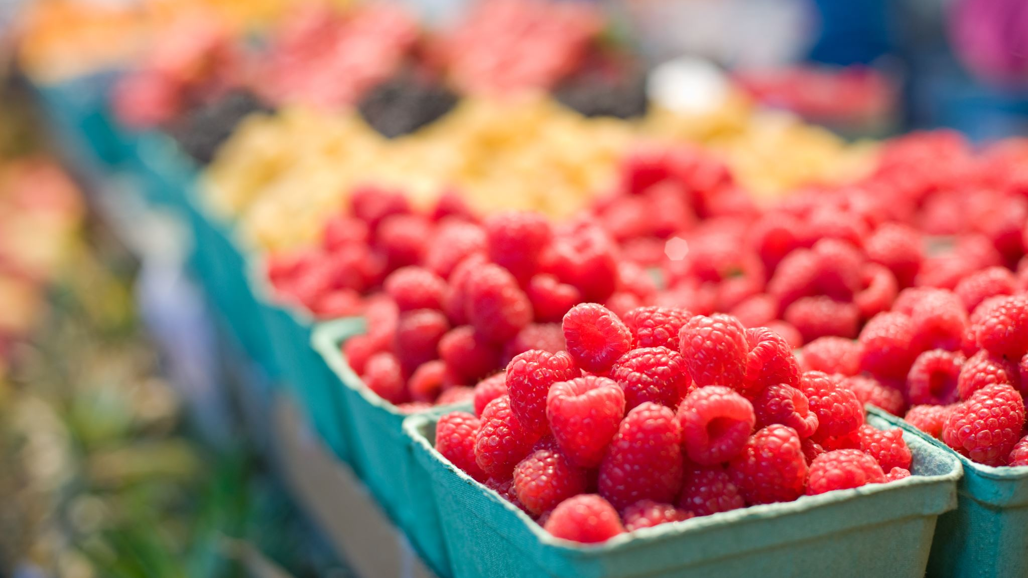
Fruit

Slide 2
Banaan

Slide 3
Peer

Slide 4
Appel

